Slide 1
World Plumbing Day March 11
By

Slide 2
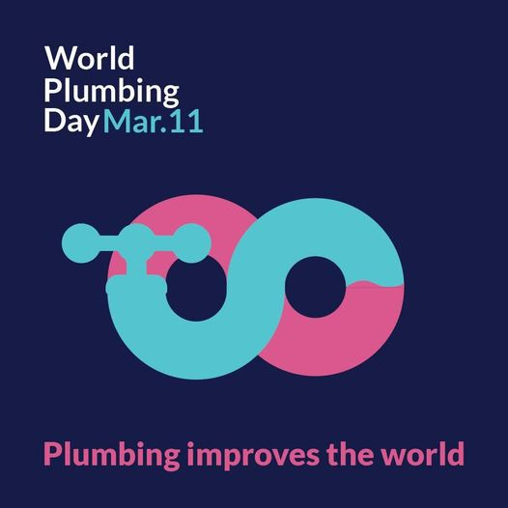
World plumbing day
Who am I?

Slide 3
Where does Water come from?
Notes:
Expected answers; The Tap, The Sea, Rivers, Streams, Rain, The Ground, Bottles

Slide 4
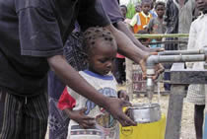
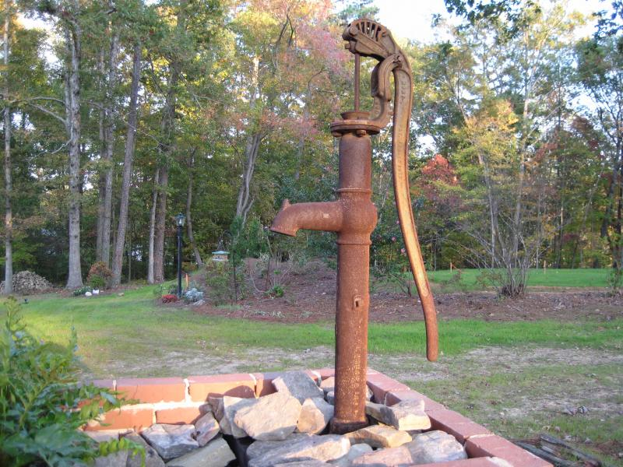
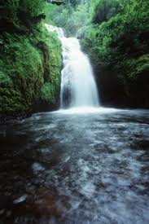
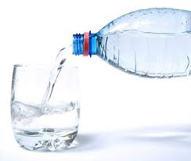
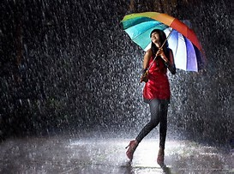
Where does water come from?

Slide 5
What do you use water for?
Notes:
Expected answers
Drinking, Cooking, Washing/Bathing, Flushing Toilets, Leisure (Swimming etc.)

Slide 6
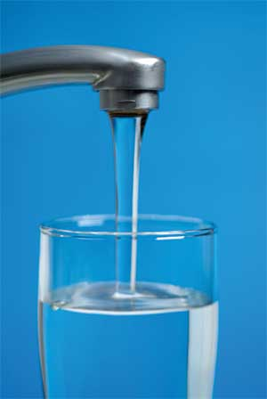
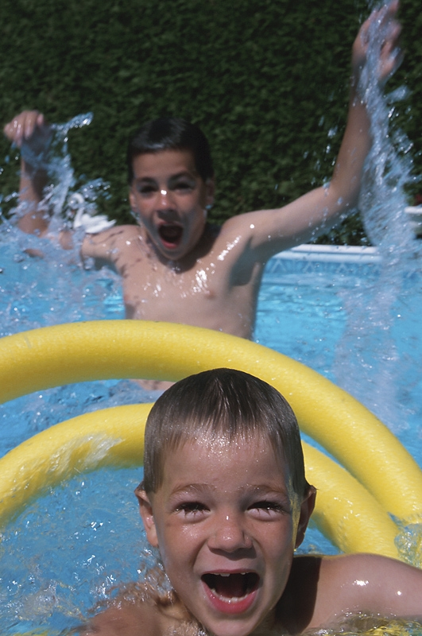
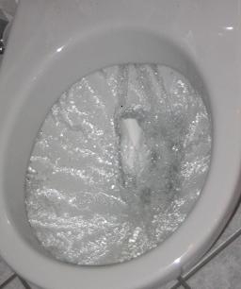
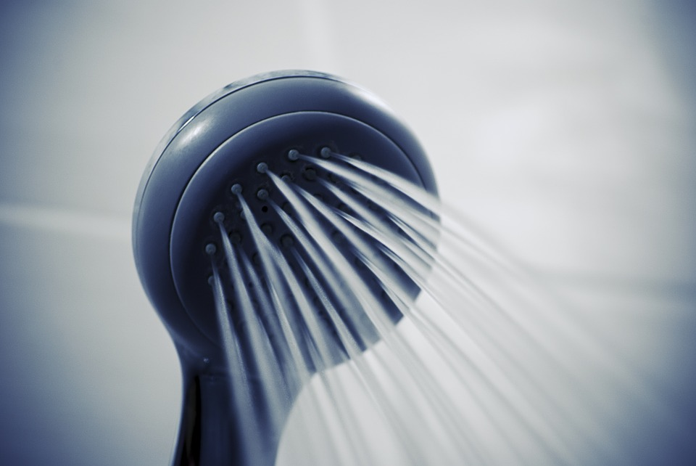
What do you use Water For?

Slide 7
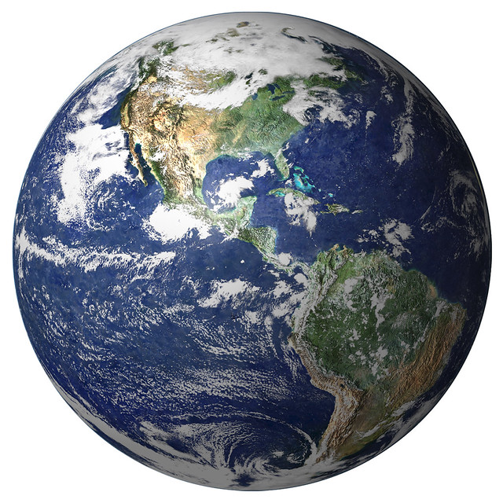
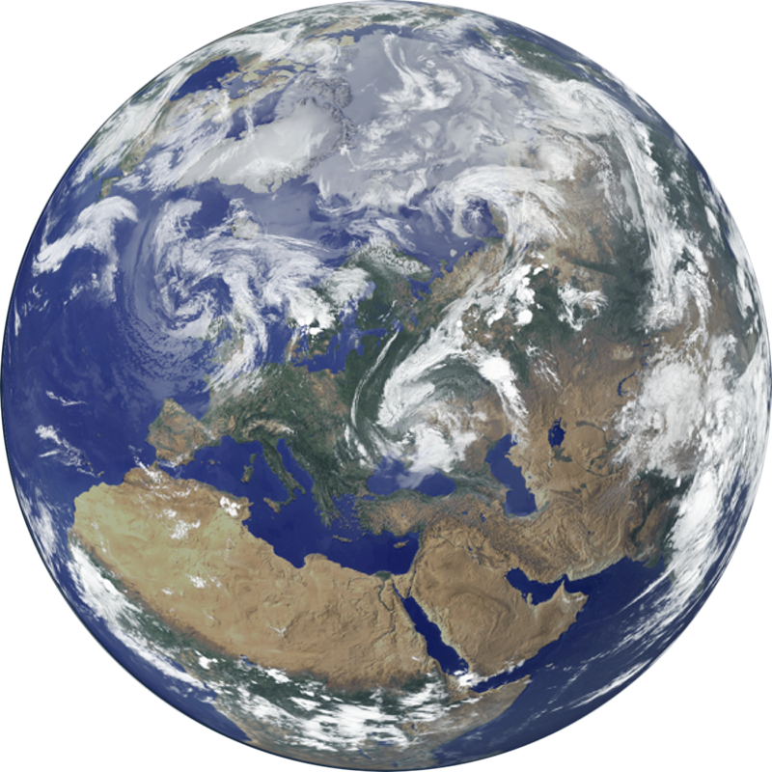
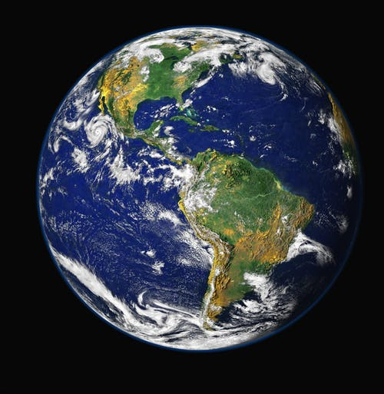
Earth is covered in water - but how much is fresh drinking water?
Notes:
Expected answers
Drinking, Cooking, Washing/Bathing, Flushing Toilets, Leisure (Swimming etc.)

Slide 8
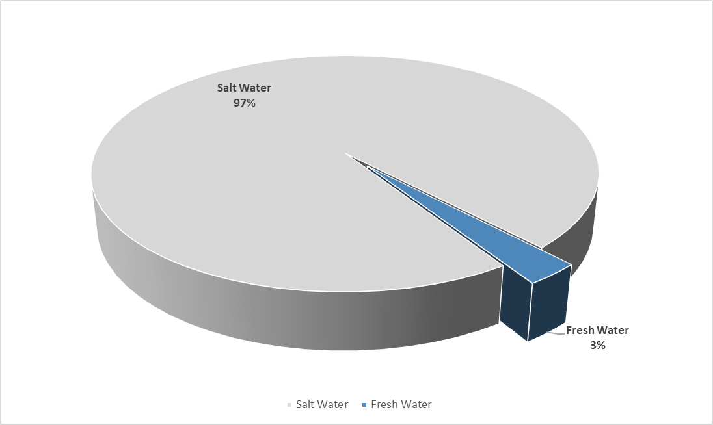
Earth is covered in water - but how much is fresh drinking water?

Slide 9
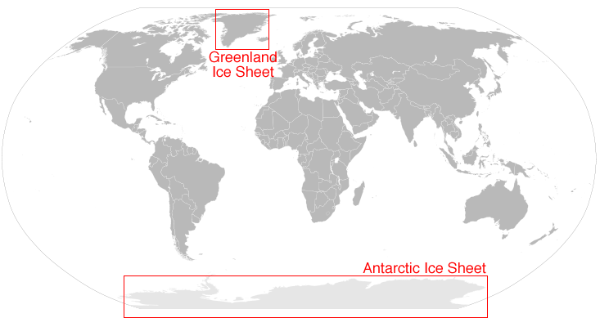
70% of the fresh water is frozen in the icecaps of Antarctica and Greenland
Notes:
The other water we drink comes from rain and snow. It is the water that fills the rivers, lakes, and streams. Water is pumped, both from groundwater or surface water sources, into pipes or tanks. The pipes eventually lead to our homes, schools, businesses, and any place where you can turn on the tap and drink water.

Slide 10
What would life be like without Water?

Slide 11
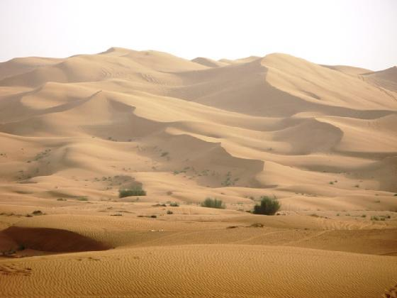
What would life be like without Water?
Notes:
Expected answers;. Dry, Dusty, Unclean, Thirsty, Unhealthy/dangerous to life

Slide 12
People are affected by poor plumbing
2,100,000,000 people do not have taps, that bring fresh water, in their house. That’s 3 in 10 people.
4,500,000,000 people do not have toilets in their house. That’s 6 in 10 people.
361,000 children aged under 5 die each year from water born diarrhoea caused by contaminated water. Almost 1,000 a day.
900,000,000 school children have no handwashing facilities.
Notes:
Encourage children to express these numbers in words (2.1 billion, 4.5 billion and 361 thousand) and relate these to the population of their own town, city and country.

Slide 13
Plumbing IS ESSENTIAL
Vital role in promoting the link between:
good quality plumbing
environmental sustainability
economic prosperity
even more than ever during the present global COVID-19 pandemic, public health and hygiene
Notes:
Encourage children to express these numbers in words (2.1 billion, 4.5 billion and 361 thousand) and relate these to the population of their own town, city and country.

Slide 14
What work does a Plumber do?

Slide 15
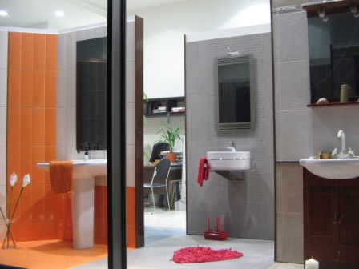
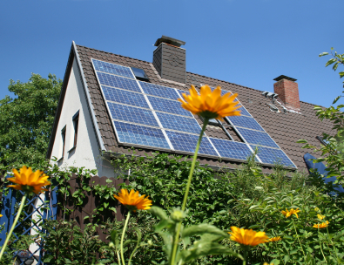
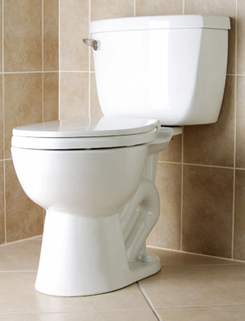
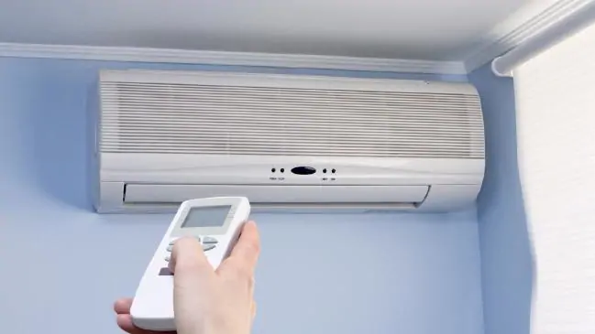
What work does a Plumber do?
They install and fix:
Bathrooms and Kitchens
Toilets
Central Heating
Solar panels
Air-conditioning

Slide 16
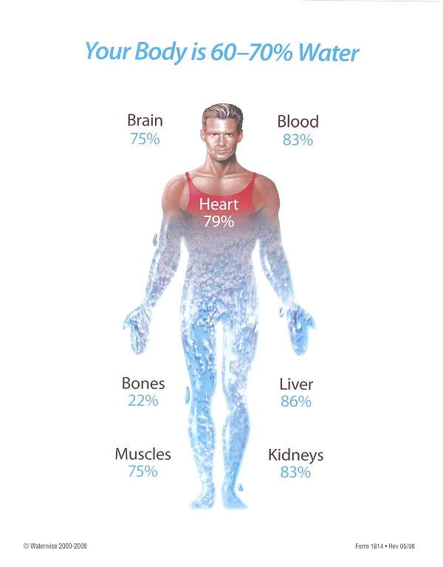
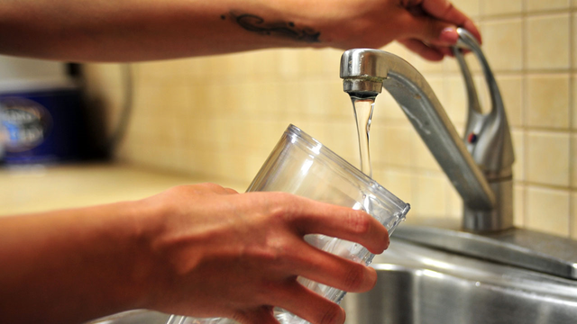
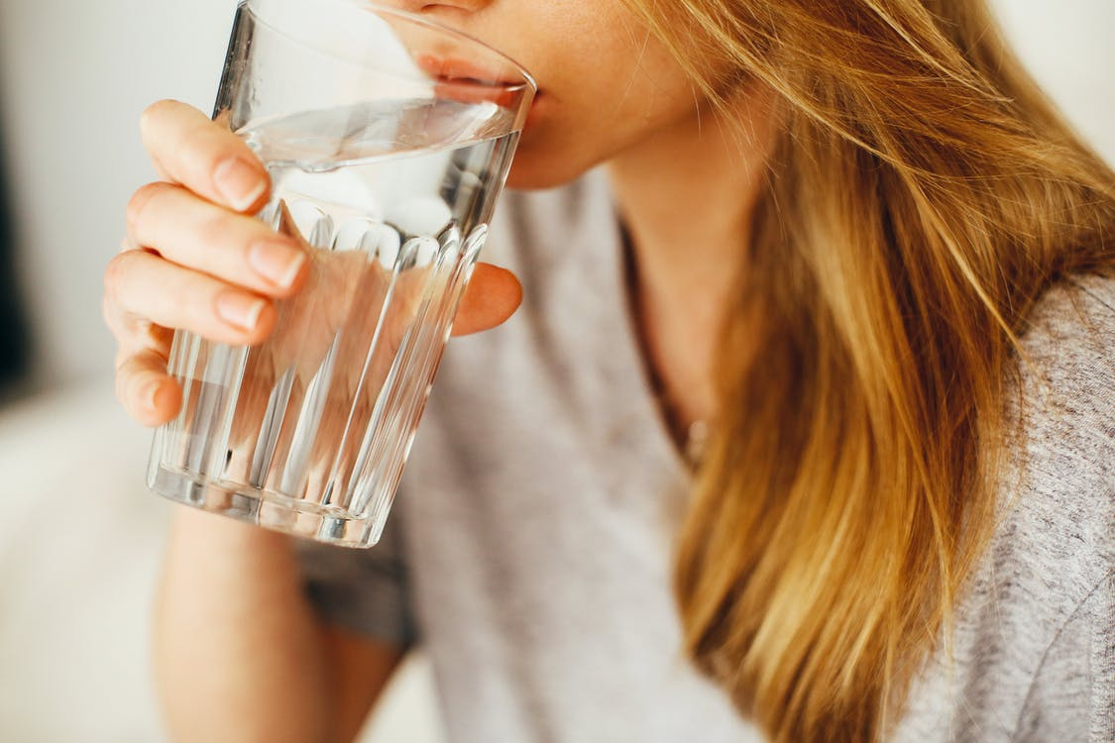
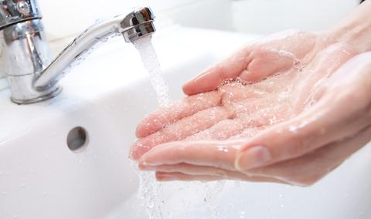
Why Is plumbing important for keeping you healthy?
60-70% of the body is made of water which makes drinking clean water from taps is essential to keep you hydrated, keep you alert and functioning properly.
Washing your hands with water and soap cleans off dangerous germs, viruses (like COVID-19) and bacteria that can make you sick.

Slide 17
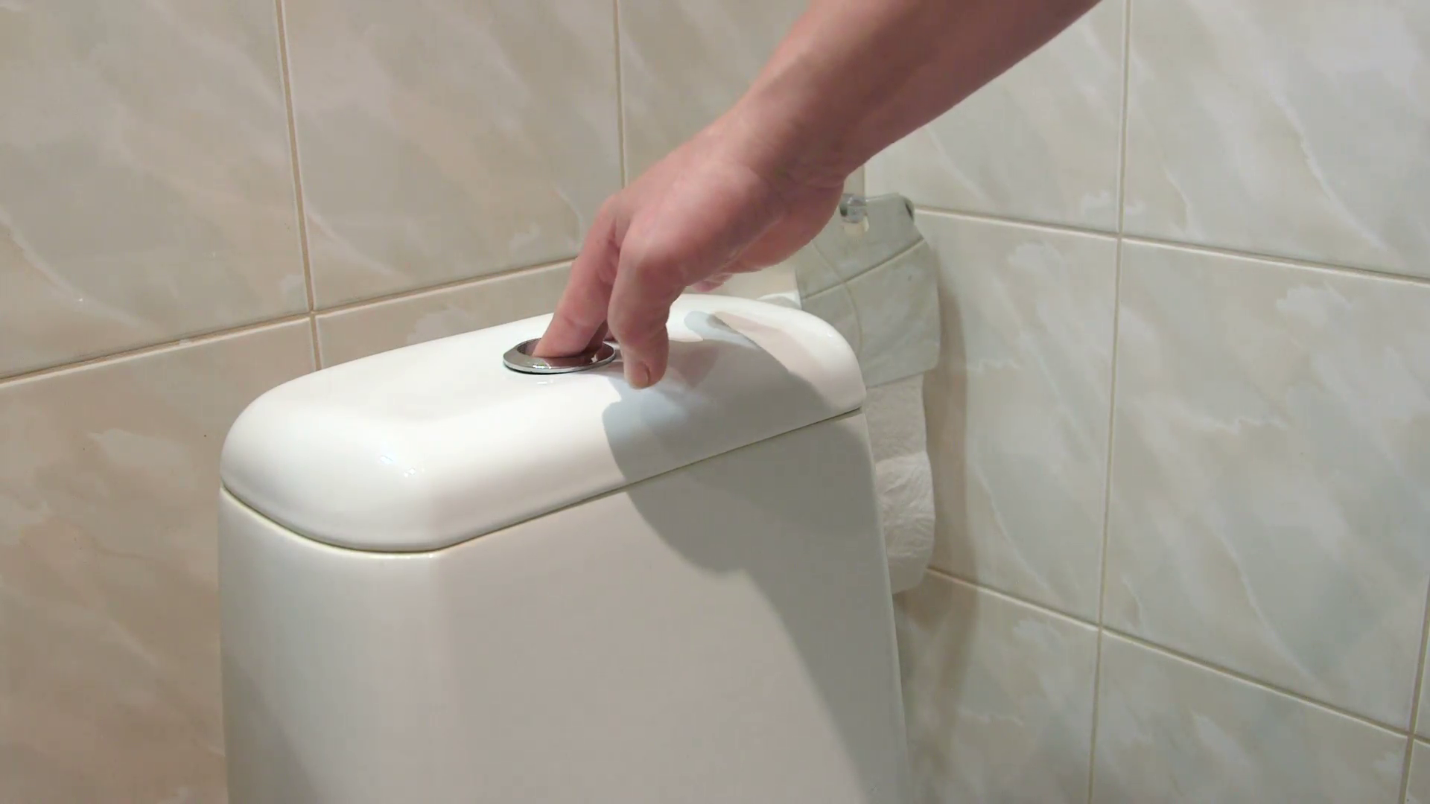
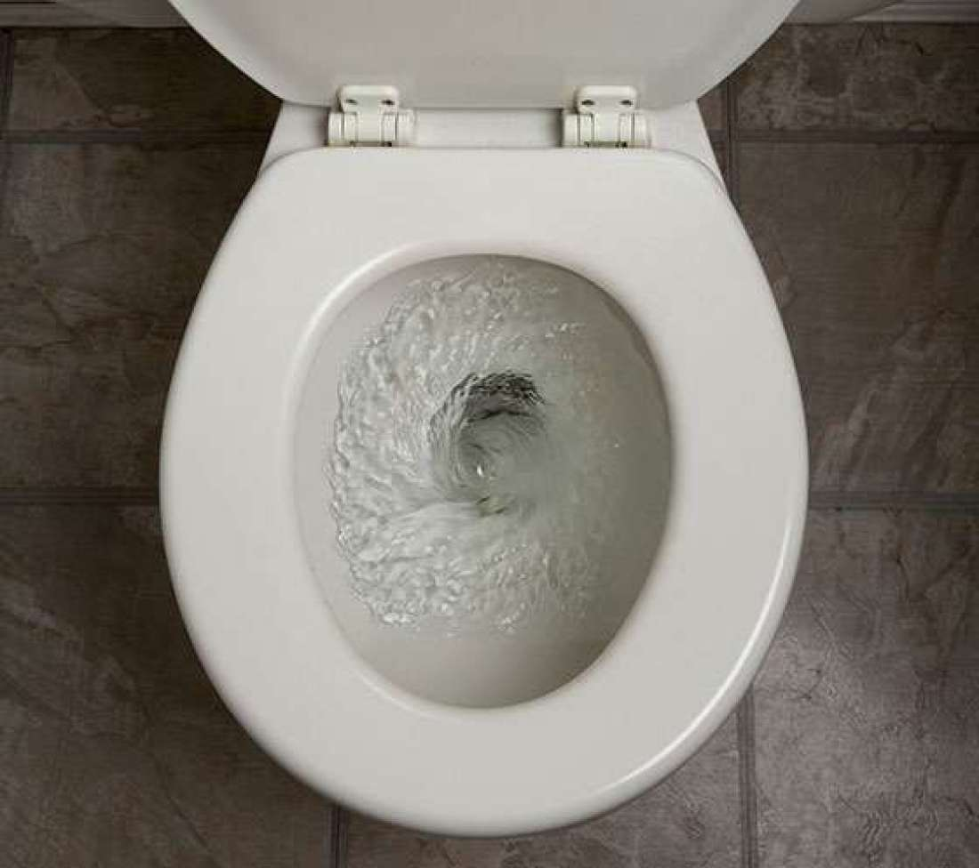
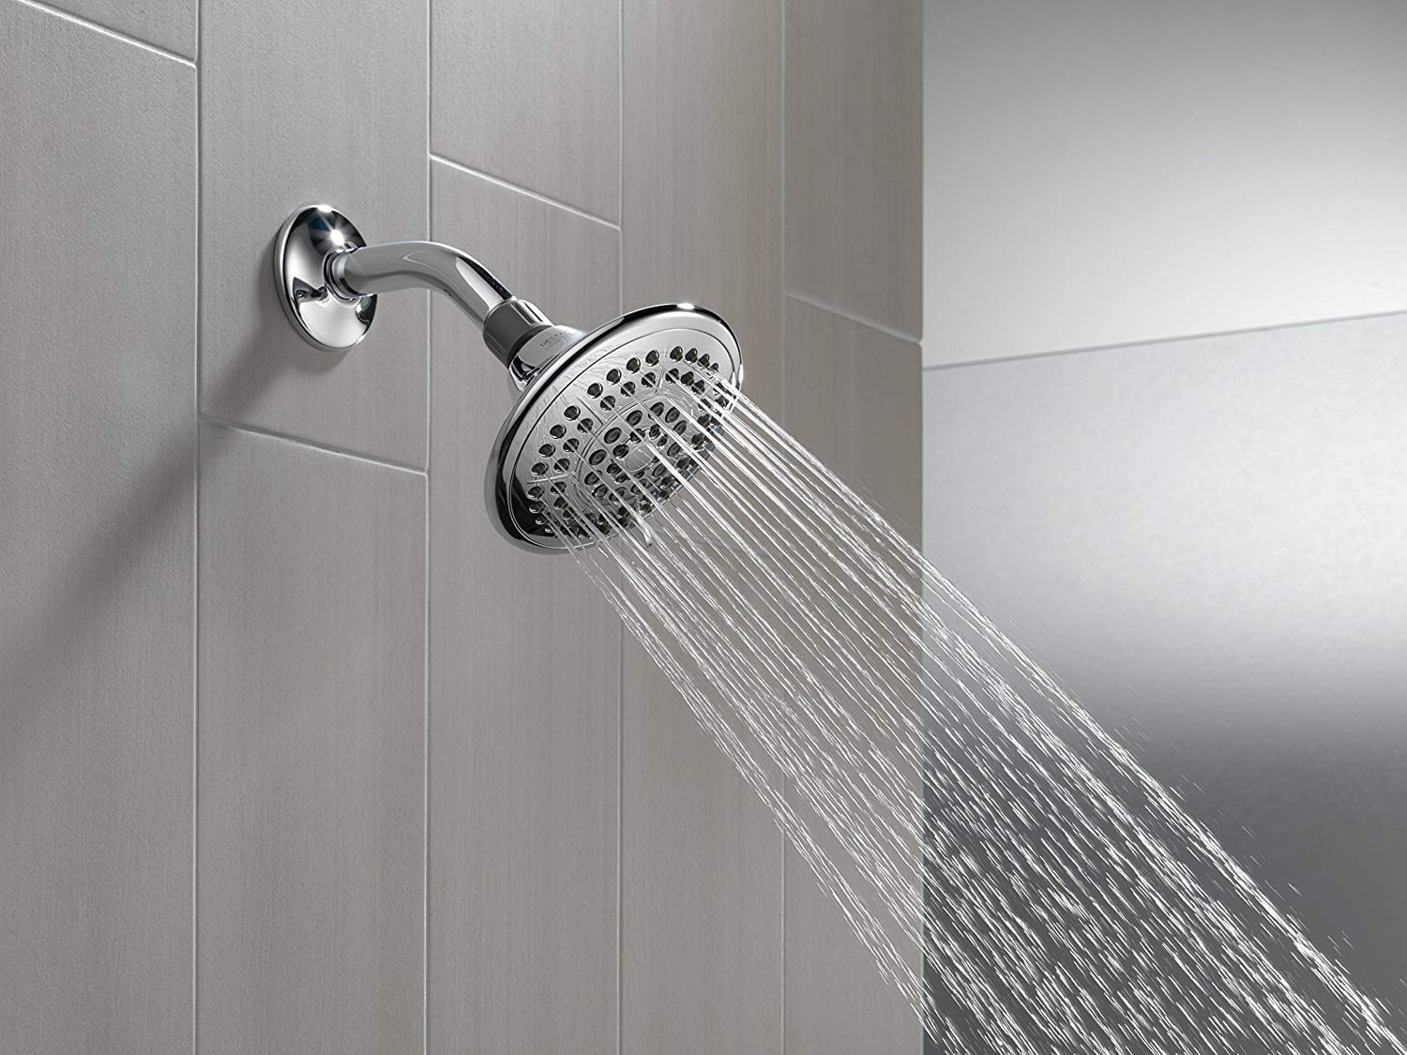
Why Is plumbing important for keeping you healthy?
Flushing the toilet takes the dirty water away to be safely sanitized so it does not contaminate your drinking water.
Taking a shower or bath cleans off the dirt and removes odours collected on your body. This helps you be hygienic and maintain your good health so you don’t get sick.

Slide 18
Poster contest
Must have the words: “World Plumbing Day” and “Plumbing Is Essential”
On standard US letter sized paper or A4
Include your name, grade, teacher, and school on the back
Notes:
All posters to be collected and sent to WPC Secretariat by 31 March.
Address: IAPMO Group, Attention: WPC Secretariat, 4755 East Philadelphia Street, Ontario, CA 91761 USA

Slide 19
Poster contest prizes – global contest
3rd place: US$25 to student; US$250 to school
2nd place: US$50 to student; US$500 to school
1st place” US$100 to student; US$1,000 to school

Slide 20
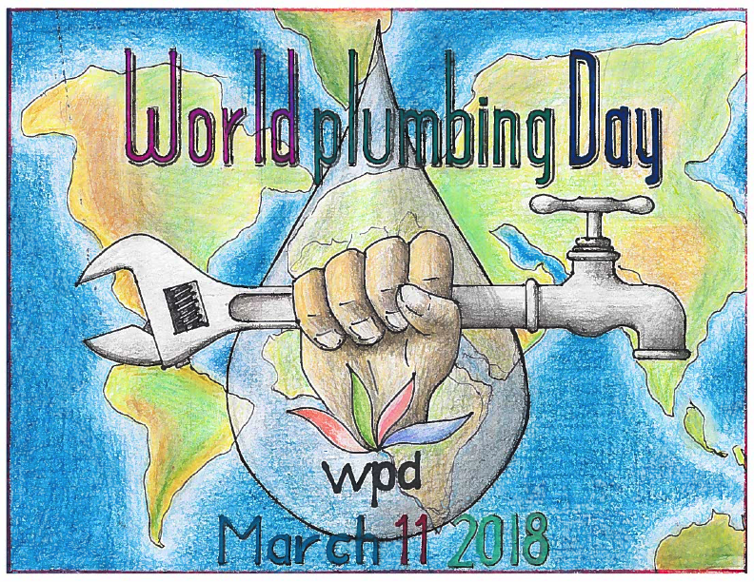
Notes:
Previous winner

Slide 21
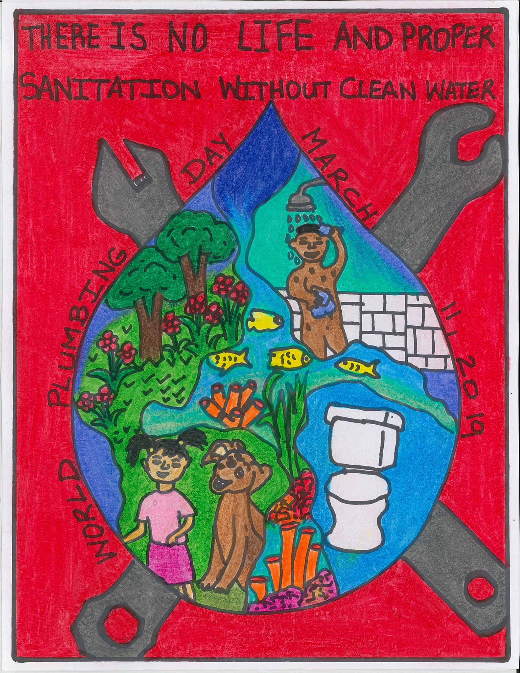
Shevan Holness
9 yrs. old – 5th grade
Jamaica
2019 entry
Notes:
Previous winner

Slide 22
Why celebrate world plumbing day?
Understand and appreciate the importance of plumbing to our health
Learn about those who lack plumbing in their home and school
Understand plumbing in different nations
Learn how proper plumbing and sanitation equal gender equality
Awareness
A desire to help others

Slide 23
Thank you!
Notes:
1. Explain that many people do not know that Plumbing is important.
2. World Plumbing Day aims to make people more aware that Plumbing is important.
3. Mention 4 key elements – Energy, Environment, Water and Health.
4. Ask Children to remember Plumbing on 11 March.

